Slide 1
ELOQUENT
EVALUATION OF GENERATIVE LANGUAGE MODEL QUALITY AND CHARACTERISTICS
Get ready for the 2nd edition!
Jussi Karlgren
Aarne Talman
Magnus Sahlgren
Ekaterina Artemova
Ondrej Bojar
Stergios Chatzikyriakidis
Timothee Mickus
Vladislav Mikhailov
Erik Velldal
Lilja Øvrelid

Slide 2
First ELOQUENT edition: 4 Tasks
Quiz: Topical competence
Hallucigen: Veracity and Hallucination
Robustness: Handling variation
Voight-Kampff: Identifying machine-generated text

Slide 3
Top level goals of ELOQUENT
assessing Trustworthiness, a many-faceted notion which involves topical relevance and truthfulness, discourse competence, reasoning in language, controllability, and robustness across varied input.
exploring effects of Multi-linguality and the notion of Cultural fit: the suitability of a language model for some cultural and linguistic area.
probing the Limits of Language Models: what is world knowledge and what is generative capacity?
making use of Self-assessment: the reliability of a language model to assess the quality of itself or some other language model, using as little human effort as possible.

Slide 4
ELOQUENT is of general interest
Several EU projects with focus on evaluation and benchmarking
This work is aligned with several AIoD projects
ELOQUENT is part of the DeployAI project

Slide 5
tasks for the 2025 edition

Slide 6
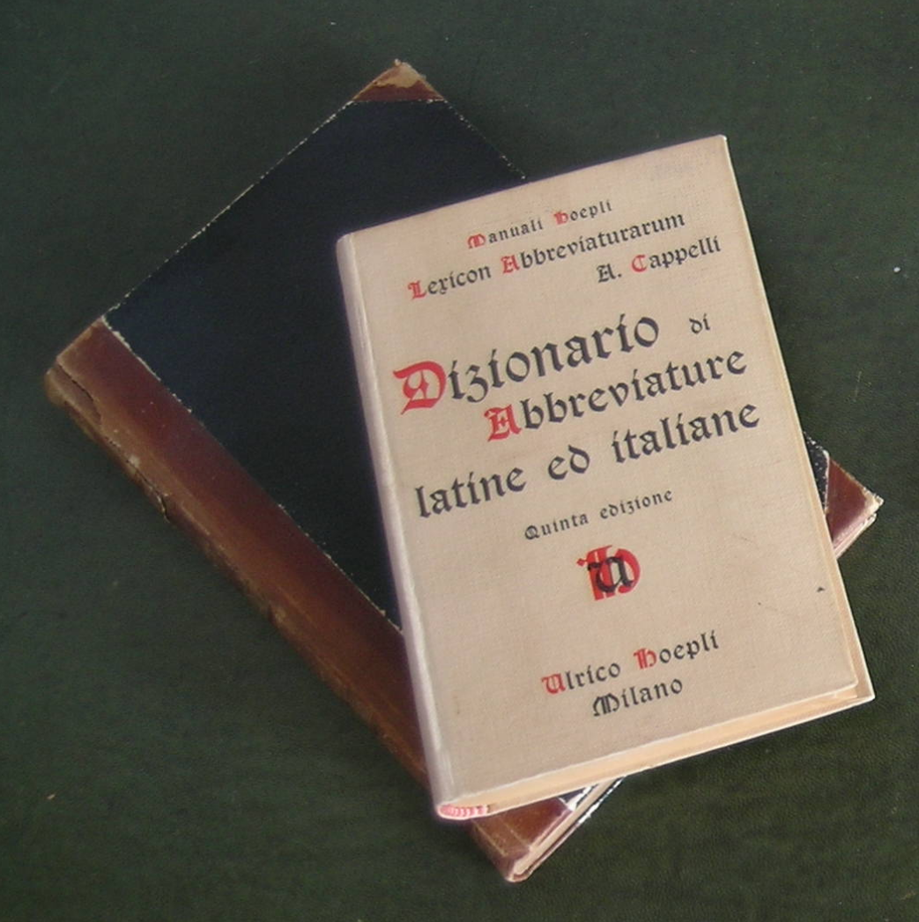
Dictionary Definition task
Can your LLM write convincing dictionary definitions?
The dictionary board game which is marketed in various languages under various names (Balderdash, Fictionary, Rappakalja, ...) is based on a player picking a rare word from a dictionary and the other players writing sham definitions for the word. Each player then needs to identify which definition is the actual one and players gain points from fooling other players into believing their suggested definitions are the actual real one.
A variant of this game will be given as a task
Entertaining low threshold entry level task for participant systems.

Slide 7
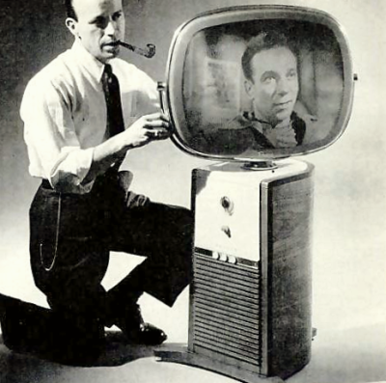
Voight-Kampff task
Can we differentiate human-generated from AI-generated text?
In collaboration with PAN lab
Builder-breaker set-up:
  Participants in ELOQUENT generate texts
  Participants in PAN build detectors
Also entry level task, easy to complete Task
This task will ask participants in the ELOQUENT lab to generate material for the PAN lab task on distinguishing human authored texts from machine generated texts, a task which has considerably public, legal, and commercial interest.
Last year, few participants
Ranking matters
Has a machine or a human written this?

Slide 8
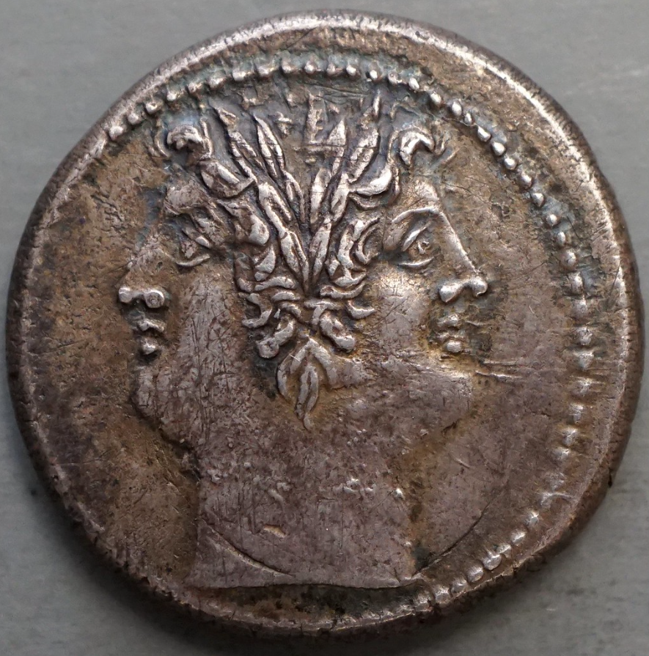
Robustness
Will your LLM tell all of us the same thing?
Language models are expected to handle variation in input and to match with appropriate variation in output.
Experiment:
  Prompts varied by dialectal, sociolectal, and idiosyncratic variation.
    Any ideas for data collection?
  Multilingual examples given
    How to use them? Ideas?
☺❀❣🎶☀
☠☢✯⛈︎❅❅

Slide 9
DIMENSIONS OF VARIATION and EXAMPLE TOPICS
formality
dialect
personal relation
sophistication
rudeness
Write to mom saying that I will not make it tonight.
Write to mommy saying that I will not make it tonight.
Write to dad saying that I will not make it tonight.
Write to my father saying that I will not make it tonight.
Skriv till mamma och säg att jag inte orkar komma över ikväll.
Skriv till mor och säg att jag inte orkar komma ikväll.
Skriv till mamma och säg att jag inte ids komma över ikväll.
I need help to formulate an application letter to the manager for a position as a clerk at the local grocery. He is a quite picky person, so it needs be written correctly.
Hey I want a job at the supermarket hlep me write a letter to the manager. He's totally anal about every fucking thing.
Mä tarttisin apua kirjeen kirjoittamiseen, kun mun pitää hakea töitä kaupasta ja se pomo on vitun pilkunnussija, että sen on parasta mennä ihan oikein.
Auta minua laatimaan työhakemus myymälään. Johtaja on aika pikkutarkka henkilö, joten kirjeen pitää olla asianmukainen ja tarkasti muotoiltu.

Slide 10
Preference Score Prediction Task
Does your LLM agree with humans?
Alignment is based on RL;HF but how about the converse?
Can generative language models reproduced human preferences?
Are systems capable of predicting Likert scores across candidate model responses for a given prompt?
Fluency, Repetition, Formatting, Relevance, Factuality, Inconsistency
Ideas? Thoughts?

Slide 11
Reasoning task
Can your LLM keep track of a .. eh ... hey ...
What?
... thought?
Reasoning is often done with language, to integrate complex information
Language models are expected to do reasoning over at least analogy, causality, and deduction
Can reasoning be investigated without depending on some topic or some knowledge?
We want to study
  reasoning in noisy dialogue environments with interjections, backchannels, split utterances
  inference based on certainty and uncertainty
  implicit evidence
Ideas? Thoughts?

Slide 12
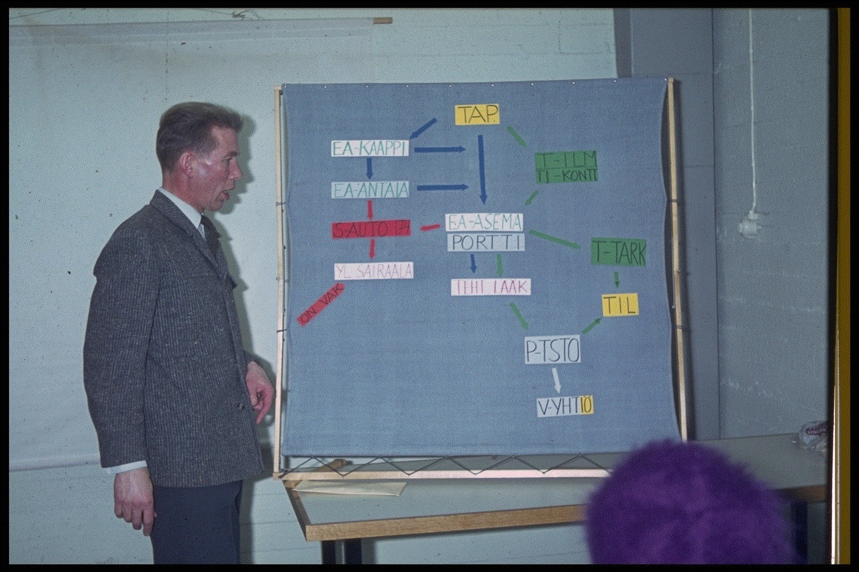
Topical Quiz Task
Is your LLM really clever? Can it mark its own homework?
Needs to be redone. Any ideas?
Last year:
Each participating system must
  accept a topic and a prompt string defined in human language,
  generate a test with a set of questions for that topic,
  accept tests generated by other systems and respond to them, and
  score responses given by other systems to the test it generated.

Slide 13
Hallucigen task
Task will move to other organisational framework for next year TBD

Slide 14
Task 1: Quiz - Does the language model know about a topic?
Can topical competence be self-evaluated using synthetic data generated by the model itself?
Round-robin task
Each participating system must
  accept a topic and a prompt string defined in human language,
  generate a test with a set of questions for that topic,
  accept tests generated by other systems and respond to them, and
  score responses given by other systems to the test it generated.
Quality of tests is probably more interesting than the quality of responses!

Slide 15
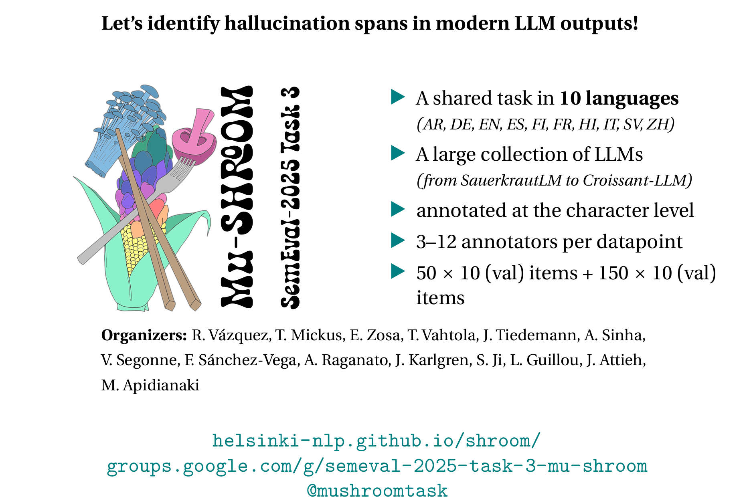

Slide 16
Second ELOQUENT edition
Can your LLM write convincing dictionary definitions?
Will your LLM give the same topic to all of us?
Does yuor LLM agree with humans?
Can your LLM fool a classifier into thinking it is human?
Can your LLM keep track of a .. eh ... hey ...
What?
... thought?
Is your LLM really clever? Can it mark its own homework?

Slide 17
once we have done this year's tasks we know how to evaluate LLMs and can distribute a conclusive report

Slide 18
once we have done this year's tasks we know how to evaluate LLMs and can distribute a conclusive report
actually, we still think there may be more to investigate

Slide 19
Jussi Karlgren
Silo AI
Aarne Talman
Accenture, University of Helsinki
Magnus Sahlgren
AI Sweden
Timothee Mickus
University of Helsinki
Erik Velldal, Lilja Øvrelid, Vladislav Mikhailov
University of Oslo
Ekaterina Artemova
Toloka AI
Ondrej Bojar
Charles University
Stergios Chatzikyriakidis
University of Crete

